Slide 1
ROI and TCO Calculations
IST615: Cloud Management

Slide 2

TCO: Total Cost of Ownership
TCO a calculation designed to help managers assess the economic value of an investment through its cost.
In the IT world, your investment is typically a service or asset.
TCO is a useful way to compare similar investments.
TCO calculations consist of both direct and indirect costs
Direct Costs: Are directly accountable to the investment. Eg. Hardware, Software, Operation, and Admin. Costs
Indirect Costs: Are not directly accountable to the investment. Eg. End user operations (support), Downtime, Loss of Productivity, Switching Costs
IST615: Cloud Management
Notes:
Direct Costs are the costs you can budget and measure.
Indirect Costs are costs of running helpdesks, the costs of users who support themselves and others, and downtime

Slide 3
TCO Example – Indirect cost comparison
I can host my Wordpress Blog:
On wordpress.com for $48/year. TCO₁
Or in my basement on an old PC for “free” (let’s assume electricity costs add up to about $35/year. TCO₂
TCO₁ = $48 + Indirect Costs₁ TCO₂ = $35 + Indirect Costs₂ $48 + Indirect Costs₁ == $35 + Indirect Costs₂ $8 + Indirect Costs₁ == Indirect Costs₂ TCO₁ Costs $8 more than TCO₂, but who supports Wordpress, Updates it, and deals with power outages as part of those indirect costs in TCO₂? Me.
Is my time worth more than $8 year? YES! Thus TCO₁ is lower.
IST615: Cloud Management
Notes:
One way to use the TCO formula is to compare indirect costs.

Slide 4
Return on Investment
ROI is a type of calculation designed to help managers assess the economic value of an investment through its potential
ROI = (gain-cost)/cost
Example gain=$7,500 cost=$5,000 ROI=50%
Positive ROI is good, negative is bad.
ROI is used in IT to help compare similar IT investments.
In IT, typically ROI is calculated over the expected lifecycle of a system or over 3 years (average life expectancy)
IST615: Cloud Management

Slide 5
ROI Example: Selling Products on the Web
You work for a parts distributor. Currently you do not sell products on line.
A recent TCO study has revealed it will cost $12,000/year to begin selling products on the web.
If you would like a 25% ROI, what is the expected gain?
If another option is to partner with Amazon.com to sell your parts on line at a cost of $5,000/year What is the expected gain for the same 25% ROI? Is it better?
If the marketing department claims that by spending $5,000 next year on local advertising they can generate an additional $9000 in additional sales.
Which option has the best ROI?
IST615: Cloud Management

Slide 6

ROI Example: Selling Products on the Web
.25 = (gain – 12000)/12000 3000 = gain-12000 gain = 15000
.25 = (gain – 5000)/5000 1250 = gain – 5000 gain = 6250
ROI = (9000-5000)/5000 ROI = 4000/5000 = .8
Option C has the highest ROI. In this example it is the best option.
Option A and B have the same ROI but option B has a lower TCO so…
Option B is better than option A
IST615: Cloud Management

Slide 7

Check Yourself
Cogswell Cogs has determined that switching from in-house accounting to a cloud accounting system will save the company $5000 /year. If it costs, $2000 /year to host the cloud accounting system, what is the ROI?
It costs $2000 / year to host accounting in the cloud, but $5000 over 3 years to rent an appliance from the same company and store it in your data center. Assuming the same indirect costs, which has lower TCO?
Now do an indirect costs comparison. At which point is the other option viable?
IST615: Cloud Management
Notes:
ROI = (gain – cost) / cost
ROI = (5000 – 2000) / 2000
ROI = 3000 / 2000
ROI = 150%
A = 2000 * 3 = 6000 over 3 years
B = 5000 over 3 years
B has lower TCO assuming identical indirect costs
In reality the indirect costs of option B need to be more than $1000 over three years for option A to be viable.

Slide 8
Backups and Data Integrity

Slide 9
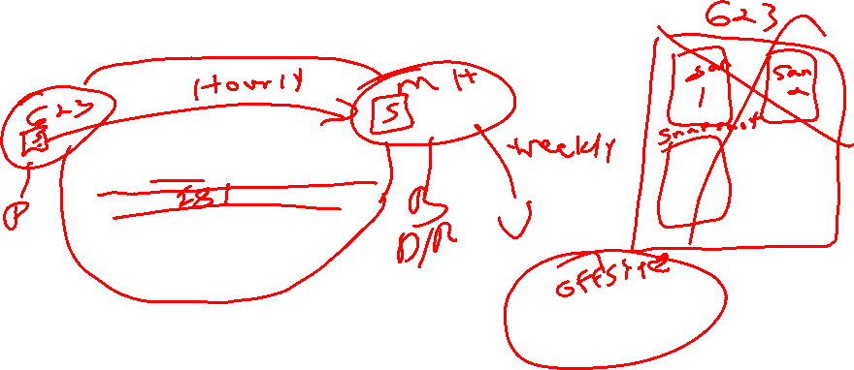
3-2-1 Data Strategy
3 Copies of your data
2 Copies are backups (one is “live”)
1 Backup Copy located in a different location

Slide 10
Why Backups?
Data gets lost
People delete data by mistake (or on purpose)
Archival Purposes
Legal Issues / Subpoenas
Data gets corrupted
Systems crash / Disks fail
Notebooks get lost / stolen
You need your backups to be reliable.

Slide 11
Multiple Ways to Backup
Image Backups
“Classic” Tape Backups
Disk-to-disk-to-tape backups (D2D2T)
Disk-to-disk-to-disk backups (disks are cheap)
Offsite Backup services

Slide 12
Why restores?
Most Common: Accidental File Deletion / corrupt data
So common that snapshot technology is used.
Mac time machine / Windows File History / system restore
Pull from Archives
Historical snapshots of data.
Need recovery of user’s files or email after they’ve left the org.
Least Common: Storage Failure
Fault-Tolerant system (RAID) failure
Loss of data and loss of service, too

Slide 13
Data Integrity
Data Integrity – ensuring your data is accurate.
How does it become corrupted?
Viruses / Malware
Buggy Software
Hardware failures
User Error
How to you ensure data integrity?
Hashing – compare file to its checksum MD5/SHA256
Keep anti-malware software current
Backing up inaccurate data is useless!

Slide 14
Types of Backups
A full backup (level 0) is a complete copy of a partition.
A differential backup (level 1) is an archive of only the files that have changed since the last full backup.
An incremental backup (level 2, 3, etc) is an archive of only the file that have changed since the last backup (not necessarily full backup.
Backup | Sun (F) | Mon | Tue | Wed | Thu | Fri | Sat
Full | 2TB | 2TB | 2TB | 2TB | 2TB | 2TB | 2TB
Diff. | 2TB | 1GB | 1.2GB | 1.6GB | 1.9GB | 2.3GB | 2.8GB
Incr. | 2TB | 1GB | 0.2GB | 0.4GB | 0.3GB | 0.4GB | 0.5GB

Slide 15
Differential or Incremental?
Differential backup Advantages: quicker recovery time, requiring only a full backup and the latest differential backup to restore the system. Disadvantage: for each day elapsed since the last full backup, more data needs to be backed up, especially if a majority of the data has been changed.
Incremental backup Advantages: quicker backup times, as only changed files need to be saved. Disadvantage: longer recovery times, as the latest full backup, and all incremental backups up to the date of data loss need to be restored.

Slide 16
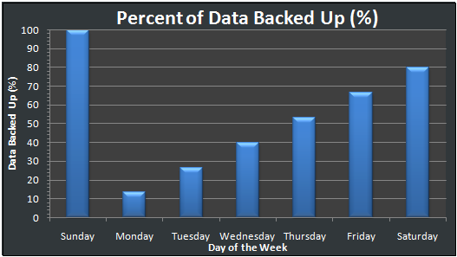
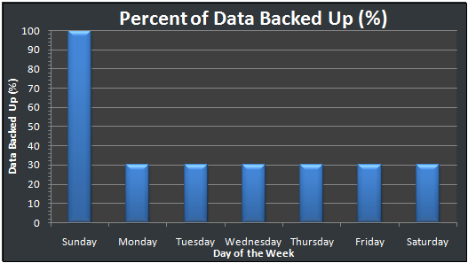
Differential vs. Incremental
Differential
Incremental

Slide 17
Testing Backups
Periodically test your backups by performing restores.
Why? The only way you know your backups are working is to restore data from them and test.
Backups are no good if you can’t restore from them.
Backups are one of the most understated processes in IT management but one of the more important.

Slide 18
Backup Strategy
You can’t backup everything all the time and keep it around forever.
It’s just not realistic.
You need a combination of short-term and long-term backups.
What if you need files from 12 months ago?
You should draft a backup and restore SLA
Through the SLA, customers know what to expect
Plan your backups around the SLA
Mitigate risk
Don’t store your backups next to your servers!
The restore requirements govern your backup strategy.

Slide 19
Backup Strategy #1
Backup
Sunday L0
Monday – Saturday L1 (Diff)
Each week, an L0 is saved for a year.
Week 52 is saved as year-end backup (not reused)
Can this strategy Restore
A file from 4 days ago?
A file from 5 weeks ago?
A file from Last July, that was deleted in August?

Slide 20
Backup Strategy #2
Backup
Full 1st Day of each month
Differential each remaining day of the month.
Media on 1st day of the month not reused.
Can this strategy Restore
A file from 25 days ago?
A file from 60 days ago?
A file from 1 year ago that was around for 2 months.

Slide 21
Disaster Recovery and Business Continuity

Slide 22
Disaster Recovery Plan
Defined: The process that allows a company to recover all systems, data, services, etc. May take hours, days, or weeks depending on number of systems used and their complexity.
Help prevent a IT Disaster From Happening in the 1st place:
Implement fault tolerance components and a solid backup and recovery strategy
Types of Fault Tolerance components:
RAID’ed hard drives
Redundant paths to your IPS or redundant IPS’
Backup power via UPS or generator (or both)
Mirrored copies of data located off-site
Mirrored servers (clusters)
VMWare or imaged servers
Read manuals and pay attention to what you are doing.
Isolate systems from other systems or to restate, don’t run multiple services on the same server.

Slide 23
What is a Disaster Recovery Plan?
A DR Plan…
Considers potential disasters.
Describes how to mitigate potential disasters.
Makes preparations to enable quick restoration of services.
Identifies key services and how quickly they need to be restored and in what order.
Only High-Risk / High cost plans should be considered

Slide 24
Disaster Recovery Plans
Define (un)acceptable loss.
Data? Productivity? Re-Creatable data? At what cost?
Back up everything.
Backup data, metadata (config), and instructions on how to restore your system.
Organize everything.
Can you find the backup tapes you need when disaster strikes? Make sure everything is clearly labeled.

Slide 25
Disaster Recovery Plans
Protect against disasters.
Natural disasters with high probability and many more.
Document what you have done.
Plan must be detailed enough for people to follow in a disaster w/o additional info. Hardcopies are key.
Test, test, test.
A disaster recovery plan that has not been tested is not a plan; it's a proposal.

Slide 26
Disaster Recovery Plan Ideas
Many places have a DR plan that says something like “buy new hardware, re-install our OS, applications, then restore our databases or data files from the previous backups”
What’s wrong with this plan ?
How long do you think this will take, a week, 2 weeks, a month?
What ‘data’ do you need to include? Is it up-to-date at your “DR” location?
To protect against or minimize data loss, data can be ‘copied’ either periodically (asynchronous) or in real-time (synchronous) from one server to another for DR processes.
Ideally the servers should be in different buildings, campuses, or even states as to guard against large scale natural disasters.

Slide 27
Asynchronous Replication
Defined: Data is refreshed or synchronizes periodically (most commonly done once per day) during periods of inactivity (night).
Advantages of asynchronous replication
Typically is less expensive. Don’t need to invest in sometimes expensive data replication software. Can use free tools, ex: Robocopy.
Can be used to restore data from.
If your data files are only refreshed nightly, the target location can be used to restore data from in the event a user deletes or corrupts data during the day or a user deletes a file.
Disadvantages:
Data is not kept 100% up-to-date at secondary site. If you run a bank or hospital, this may cause health, legal, or financial issues !

Slide 28
Synchronous Replication
Defined: Data is replicated from primary site to secondary site in “real-time - automatically”. No period sync process
Advantages of synchronous replication
Data is always up-to-date at secondary site. Don’t need to worry about what ‘work’ needs to be re-entered by your users.
If you are replicating from SAN to SAN, you may be able to use some of the DR hardware at secondary site for non-production purposes (allows your servers to do double-duty) such as to run reports. If needed, this DR hardware can quickly be re-setup for production need. Works great if you are using virtualization.
Disadvantage:
Costs money, may requires additional products (cost), and adds complexity to running systems

Slide 29
Business Continuity
The organization’s ability to continue to function during and after the disaster.
Think of BC as your fallback plan for the disaster.
It is not the same as disaster recovery, but ultimately a part of it.
Example:
Labor Day storm 1998. Power was out for 10 days.
Company Sold/Rented Generators
Sales and Rentals would be processed manually (on paper) and then recorded into the system when it came back on-line.

Slide 30
Business Continuity, another example
Snowstorm in 2011. Computers across an entire organization’s site were down when snow took out their terrestrial satellite links (wide area network for them at the time.
The customer service departments kept printed and bound copies of all of the service manuals for every piece of equipment the company had ever designed at their desks. When the network was down they could not access the electronic manuals, so the were able to fallback to the printed copies.
How would SU provide access to all university members to be able access SU applications remotely?

